Slide 1
Fission in FISPACT-II
FISPACT-II workshop, NEA/OECD

Slide 2
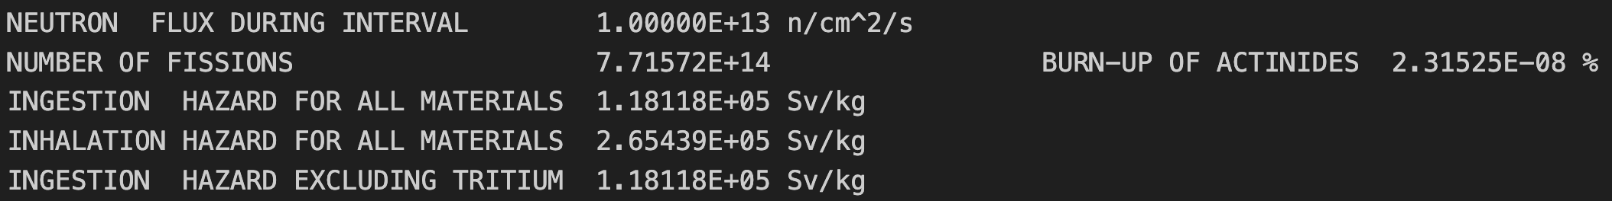
Fission in FISPACT-II
FISPACT-II is cable of including fission in inventory calculations but will not do so without additional inputs.
If the initial composition contains actinides fission should be included. If a user is unsure, check the output file:
If NUMBER OF FISSIONS is greater than zero == a fission channel is open!
[tally of MT18 (n,f)]
To include fission:
Load Fission Yields (via the files file/Nuclear Data Object)
Turn on the fission process (USEFISSION)
Input which nuclides to be allowed/disallowed to undergo fission (FISYEILD)

Slide 3
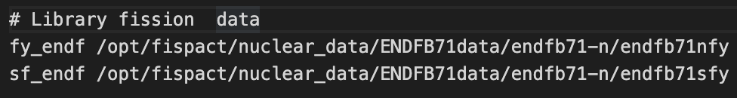
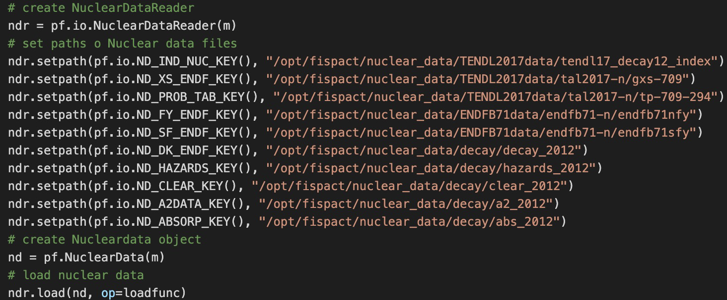
Loading Fission Yields
Two types of fission yields in FISAPCT: Spontaneous and Induced.
Spontaneous yields cover spontaneous fission. A decay process.
Induced fission yields are those from (n,f) reactions (MT18)
NOFISS keyword prevents yields form being read (before FISPACT keyword).
FISPACT uses these to populate the inventory with the correct fission products
Allows reuse of files file
Loading via the files File:
fy_endf : Induced fission yield files
sf_endf : Spontaneous fission yield file
Loading via the API:
Including these in a files file or API nuclear data object will cause FISAPCT-II to load the fission yield data.

Slide 4
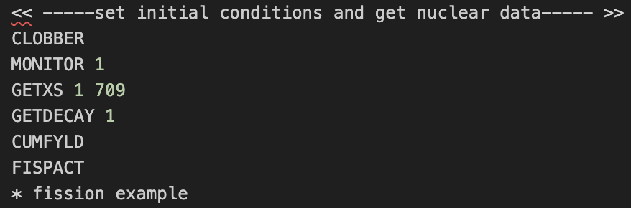
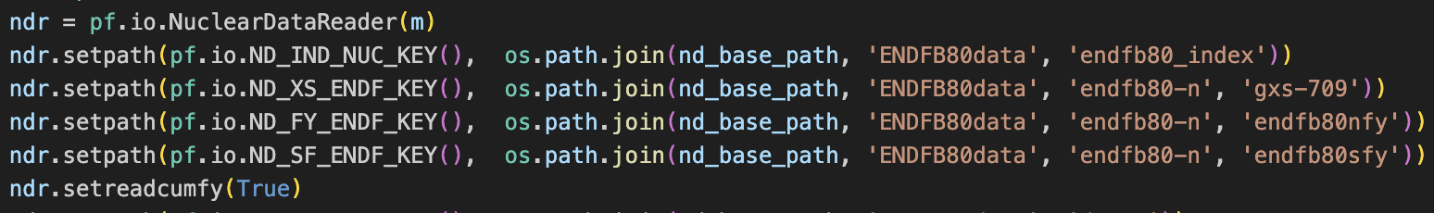
Include fission in inventory
Fission can be turned on/off in FISPACT-II:
In the input file:
USEFISSION keyword turn on fission (after FISPACT keyword).
In the API, the InputData Object includes the setusefission method:
True for fission to be on, False to turn it off.
By default, FISPACT-II uses independent (MT454) yields. To use the Cumulative fission yield data:
CUMFYLD keyword (before FISPACT keyword) should be included in the input file.
setreadcumfy to True in API NuclearDataReader object.
Example: use of setreadcumfy(True) in FISPACT Python API
Example: use of CUMFLD in FISPACT-II input file

Slide 5
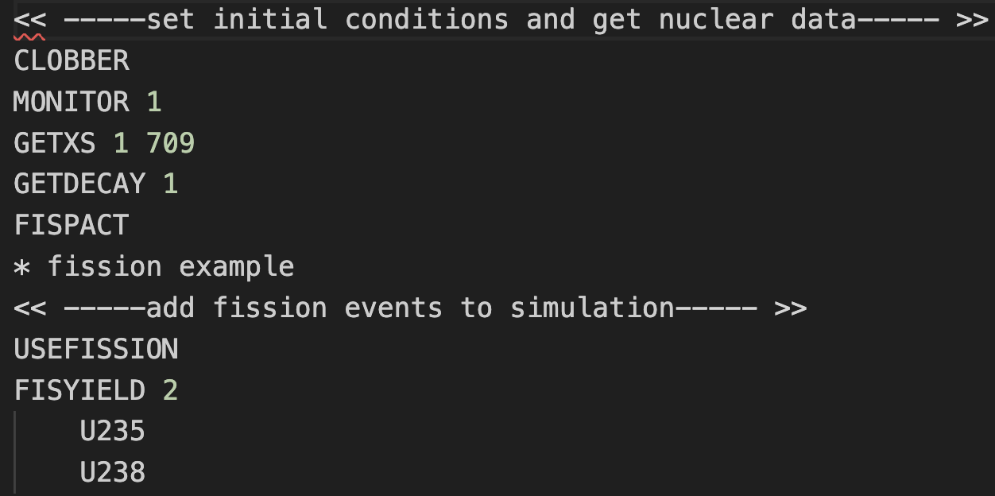
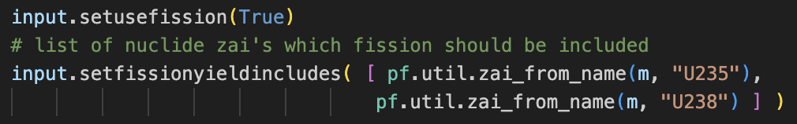
Including fission on Nuclides
FISPACT-II will only allow fission to occur on a subset of nuclides.
A user must specify which nuclides should be allowed to undergo fission via the FISYIELD keyword.
Any number of nuclides can be set.
Example: Include fission on U235 and U238 only
Input file syntax:
FISYIELD <number of nuclides>
nuclide 1
nuclide 2
etc.
If only 1 nuclide, can be single line: FISYIELD 1 nuclide
FISPACT API has setfissionyieldincludes method to set which takes a list of nuclides to use
Example: Include fission on U235 and U238 in Python API.
Here input is a pf.InputData object and pf is pyfispact module

Slide 6
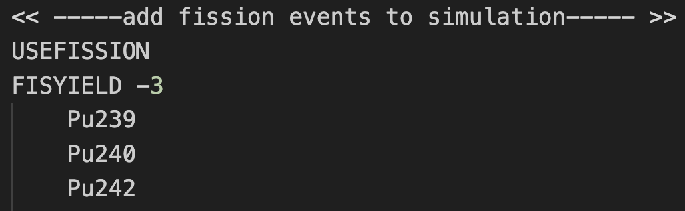
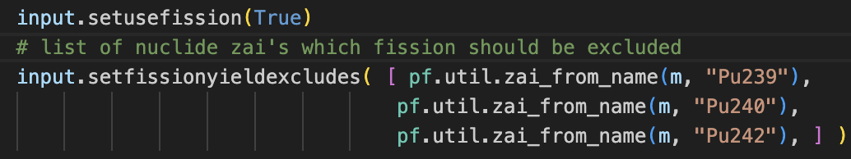
Excluding fission on Nuclides
Fission can be turned off for a subset of nuclides.
If the FISYIELD keyword in invoked with a negative argument fission is disabled for the given nuclides.
FISYIELD 0 disables fission for all nuclides.
Fission is allowed for all other nuclides.
FISPACT API has setfissionyieldexcludes method for exclude fission on a set of nuclides.
Also, setfissionyieldexcludeall method is available [equivalent of FISYIELD 0]
Example: Exclude fission on Pu239, Pu240 and Pu242.
Same input file syntax as before
Example: Exclude fission on Pu239, Pu240 and Pu242 in FISPACT Python API.

Slide 7
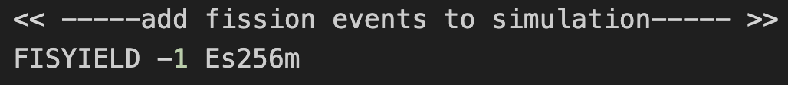
All possible fissions
All nuclides included in fission yields could also be added individually if desired. This will include all possible fissions
However, the same result can be obtained via a little trick
If fission is excluded on a fictitious nuclide, it will be included on all existing nuclides.
Usually, we suggest that users exclude the non-existent nuclide Es256m:
Input file
Example: Exclude fission on Es256m to include fission on all others.
Python API

Slide 8
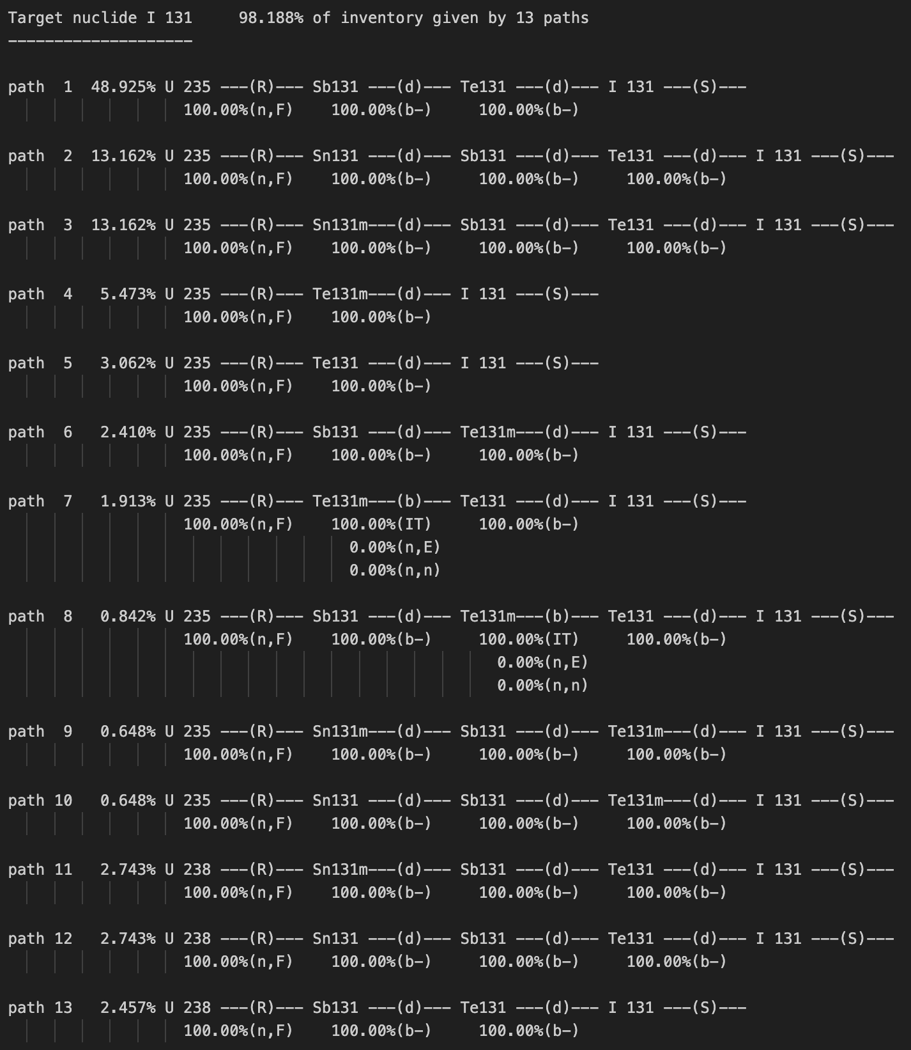
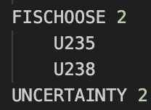
Include fission in Pathways
Fission can be included in FISPACT-II’s uncertainty-pathway analysis
[see presentation on Uncertainties and Pathways]
This is done with the FISCHOOSE keyword. Once again which nuclides should be included is given by the user.
Allows only specific fission pathways to be included.
Uncertainties and Pathways are currently not available in the FISPACT API.
Example: Pathways to I131 from U235 and U238

Slide 9
Example
Irradiation of UO₂ (3% U235) fuel with a PWR spectrum:
Only allow fission on U235 and U238 for this example.
Spectrum taken from FISPACT reference spectra: https://fispact.ukaea.uk/wiki/Reference_input_spectra
Use Nuclear Data from ENDF/BVIIII library (xs, decay and fission yields).
Use independent induced fission yields
Irradiate material for 1 year.
Output inventory every 3 months during irradiation.
Let inventory cool for 100 years:
Cooling times: 1hr, 1day, 1year, 5years, 10years, 50years, 100years

Slide 10
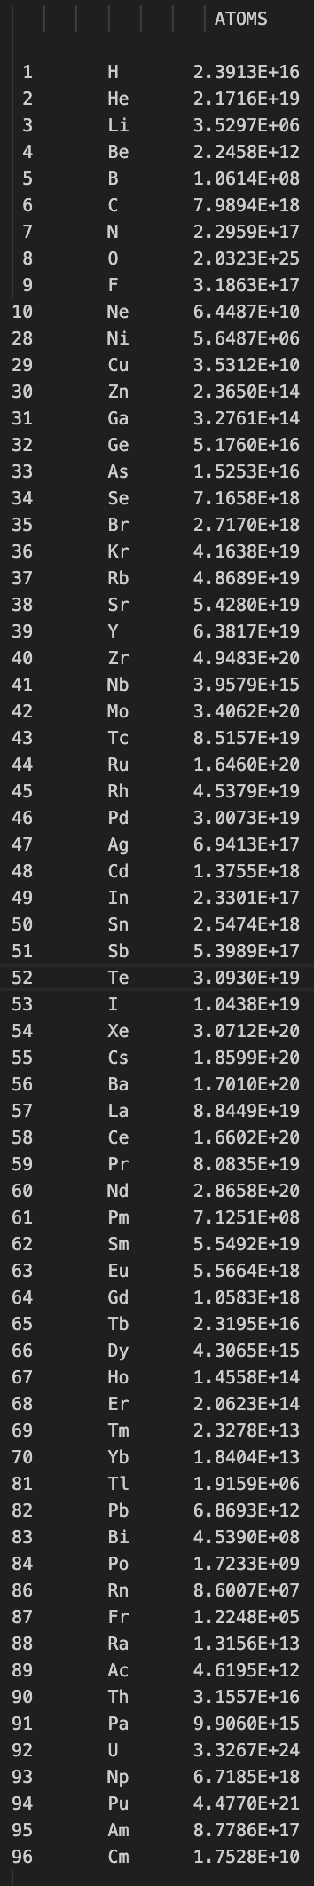
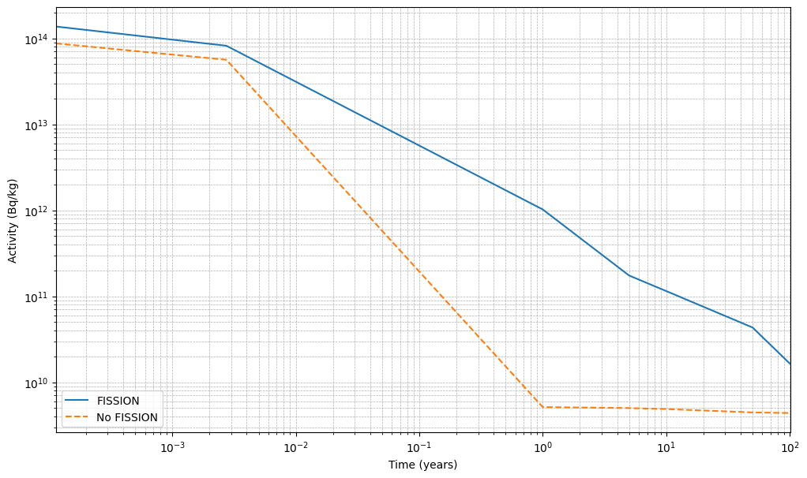
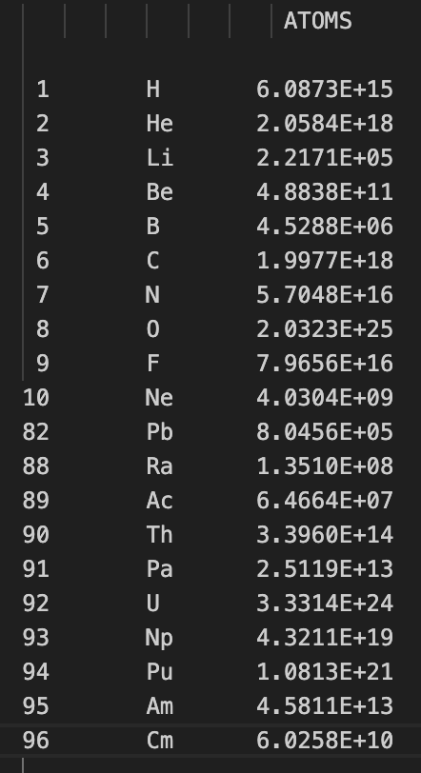
Results
Including fission in an inventory calculation will produce the correct fission products and therefore correct inventory quantities
Inventory atoms by element with fission
Taken from COMPOSITION OF MATERIAL BY ELEMENT section of FISPACT-II output file
Includes fission on U325, U238
Inventory atoms by element without fission
No fission
Time after irradiation

Slide 11
Summary and extension
Fission can be included in FISPACT-II simulations by loading the required data and using the related keywords.
Include fission yield sin files file or API nuclear data object
Include USEFISSION keyword or Inputdata.setusefission to True
Define which nuclides should under fission:
FISYIELD < number of nuclides > <list of nuclides >.
< number of nuclides > Positive for include, Negative for exclude
API use Inputdata.setfissionyieldincludes and Inputdata.setfissionyieldexclude
Extensions to example:
What if all possible fissions were included?
How does using Cumulative yields effect the results?

